Slide 1


Shendy Gunawan
Purwadhika jcDS 1702
Capstone Project module 2
Airline passenger satisfaction

Slide 2

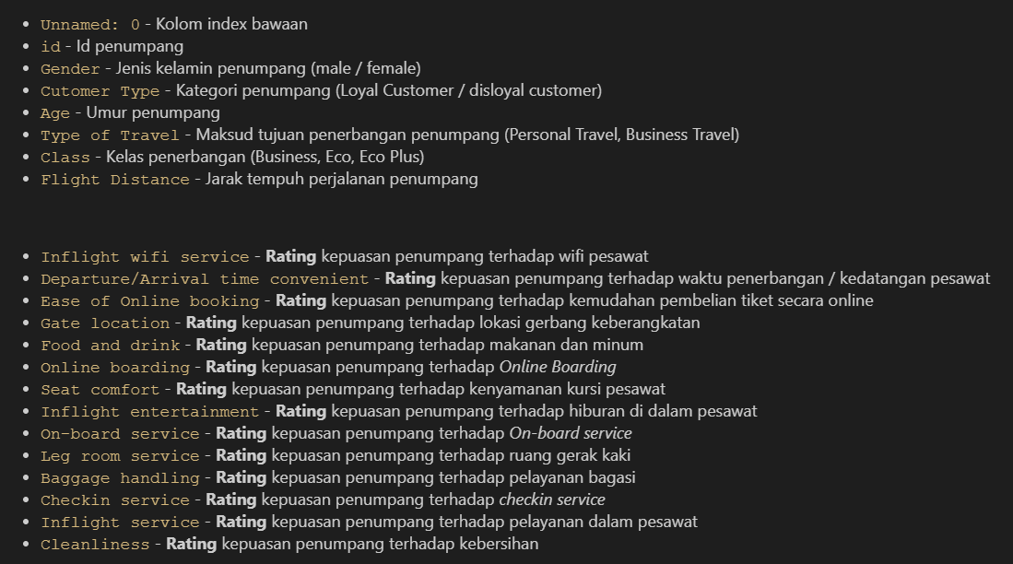
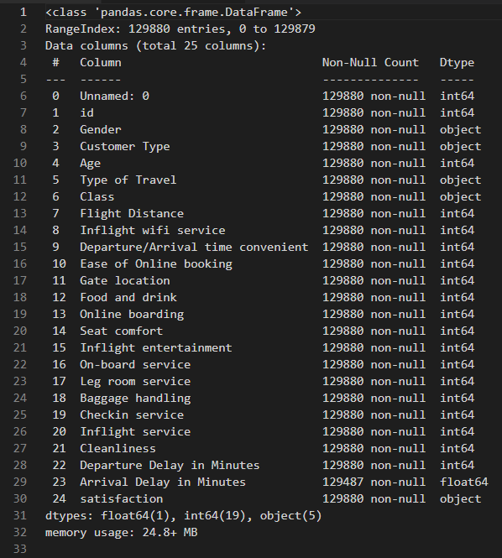
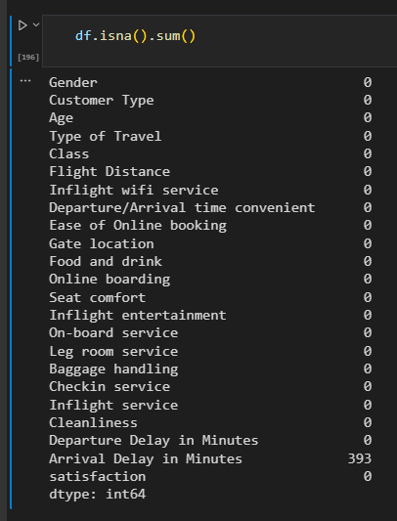
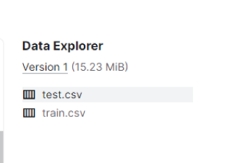
Data Understanding
K
Kolom data
Tipe Data
Data Null

Slide 3
Tujuan Analisa
K
Satisfied
Neutral or dissatisfied

Slide 4
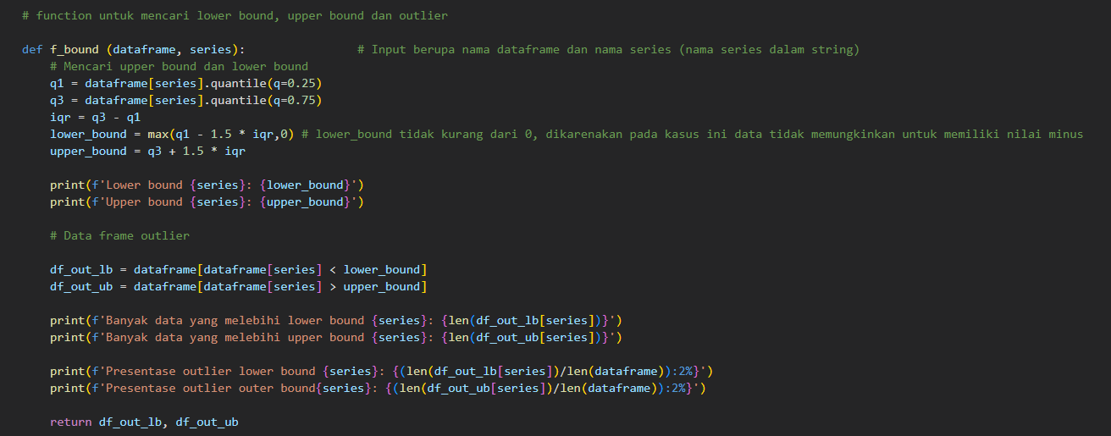
Data Anomaly
K
Fungsi untuk mencari outlier

Slide 5
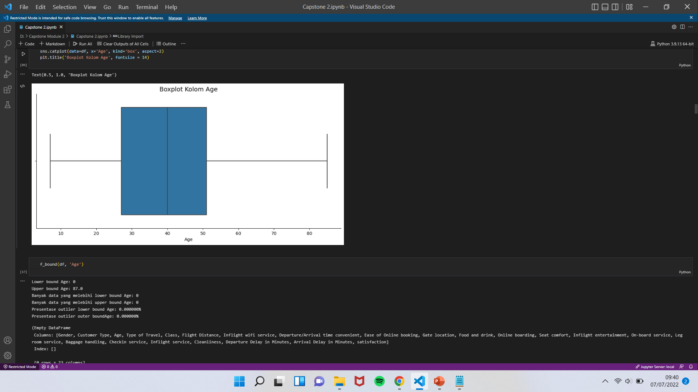
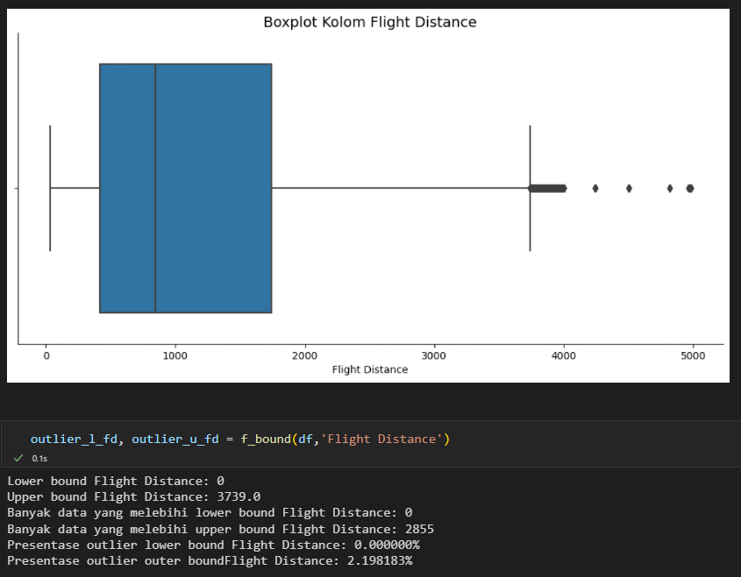
Data Anomaly
K
Boxplot Age
Boxplot Flight Distance

Slide 6
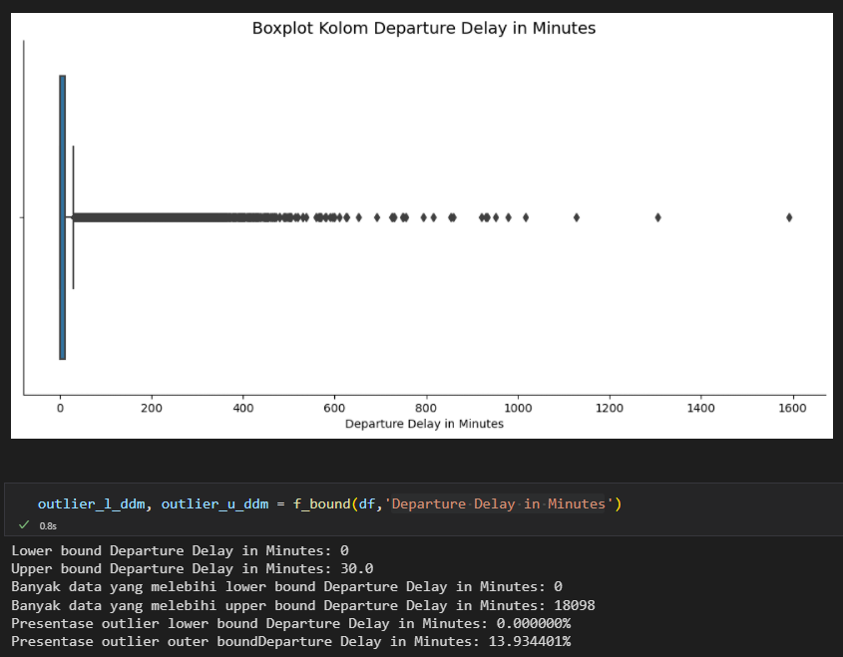
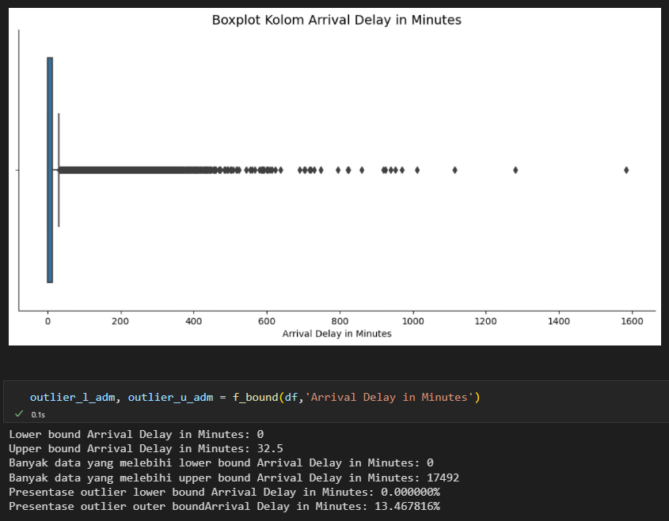
Data Anomaly
K
Boxplot Departure Delay in Minutes
Boxplot Arrival Delay in Minutes

Slide 7
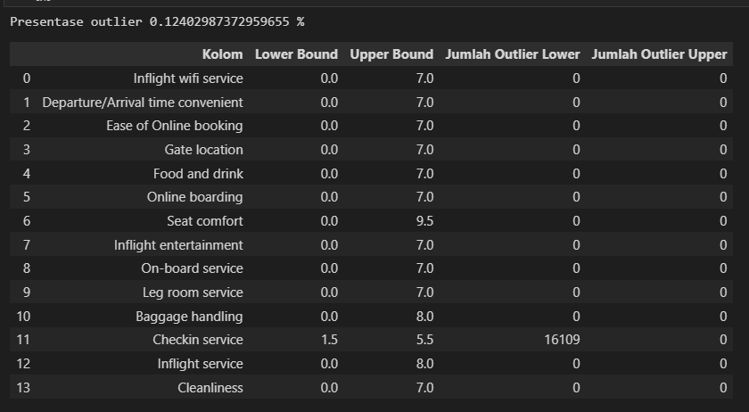
Data Anomaly
K
Outlier pada Rating

Slide 8
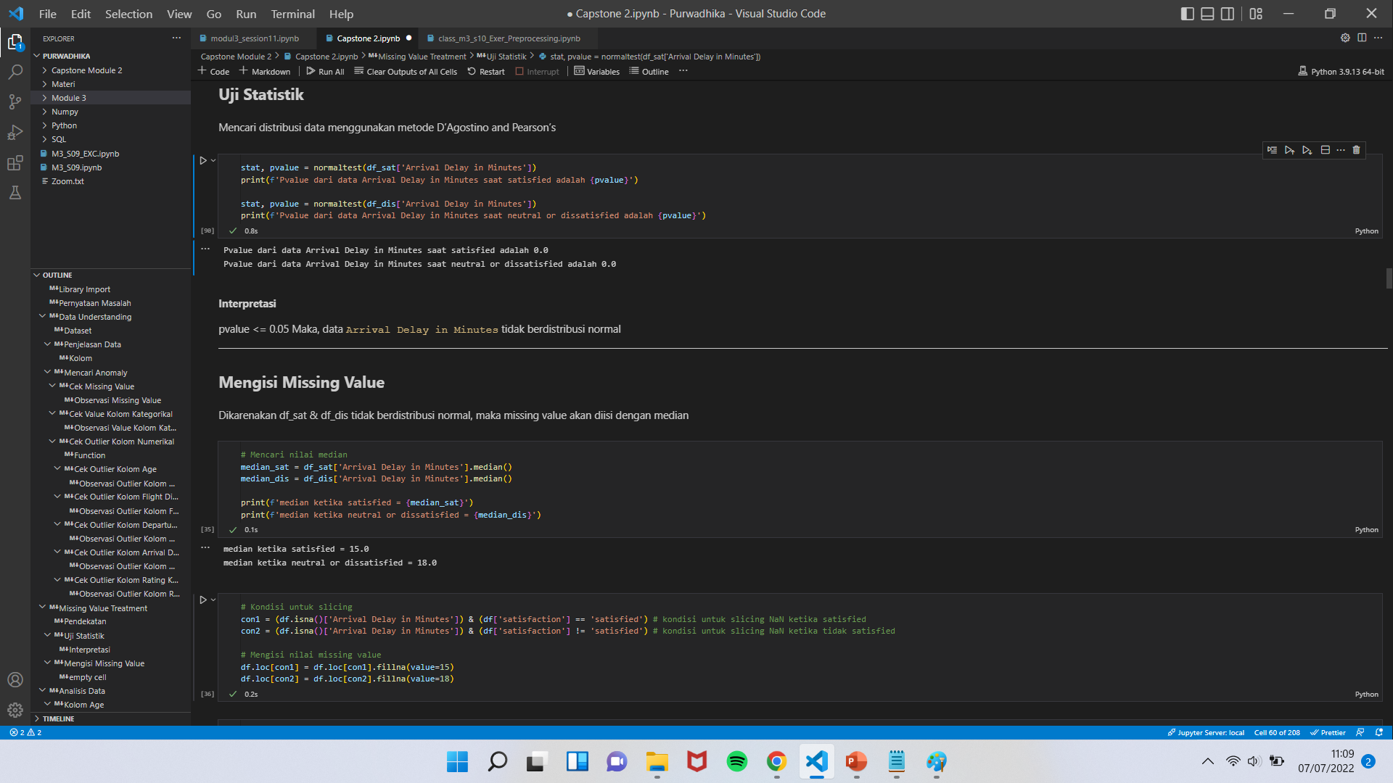
Anomaly Treatment
K
Normality Test
Mengisi Missing Value

Slide 9
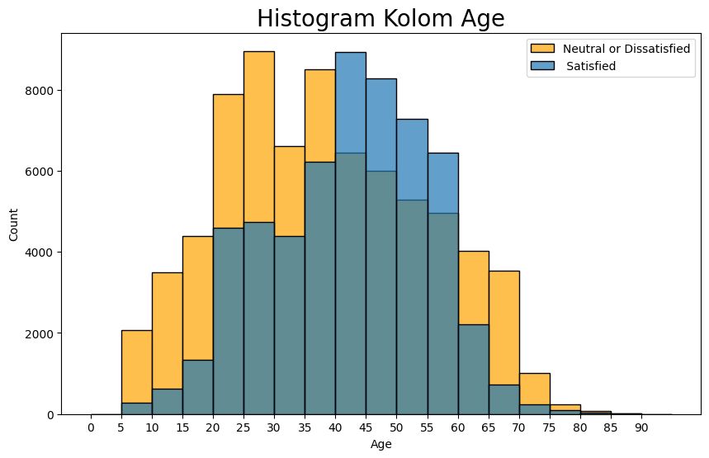
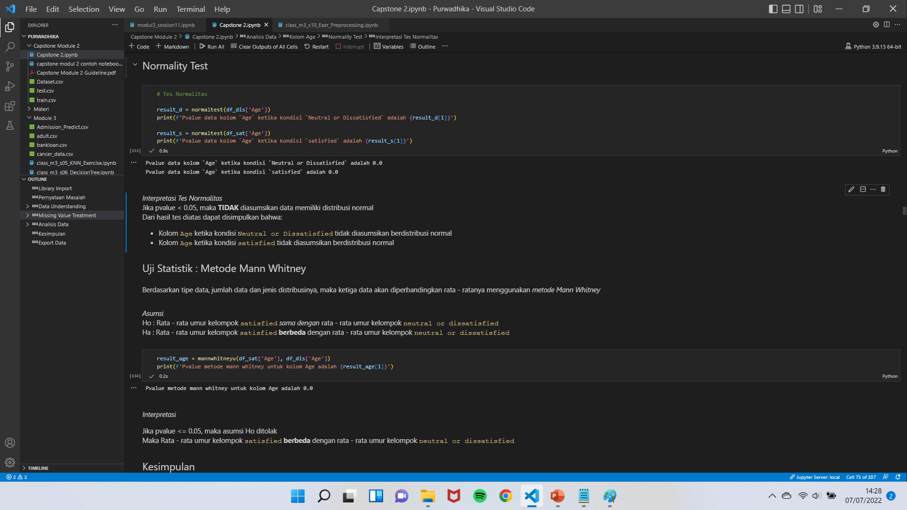
Data Analysis
K
Uji Statistik

Slide 10
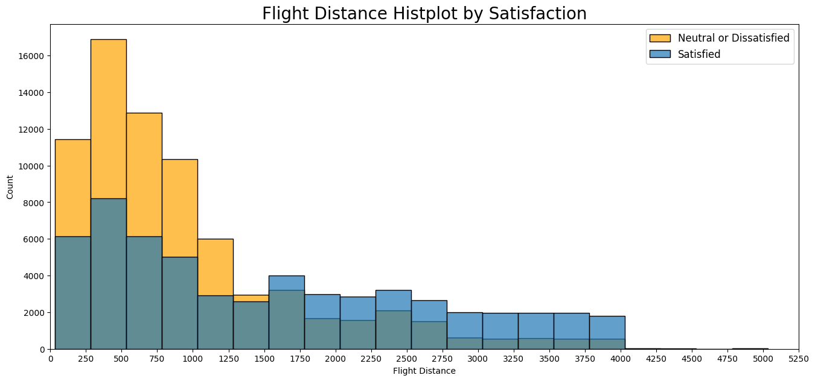
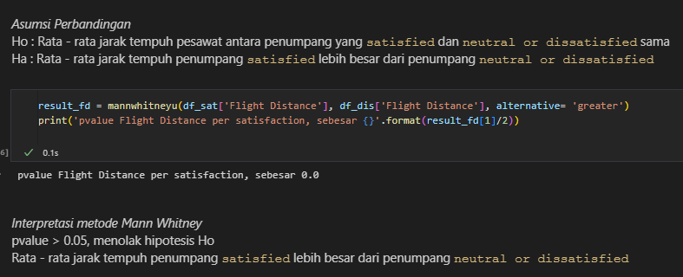
Data Analysis
K
Uji Statistik

Slide 11
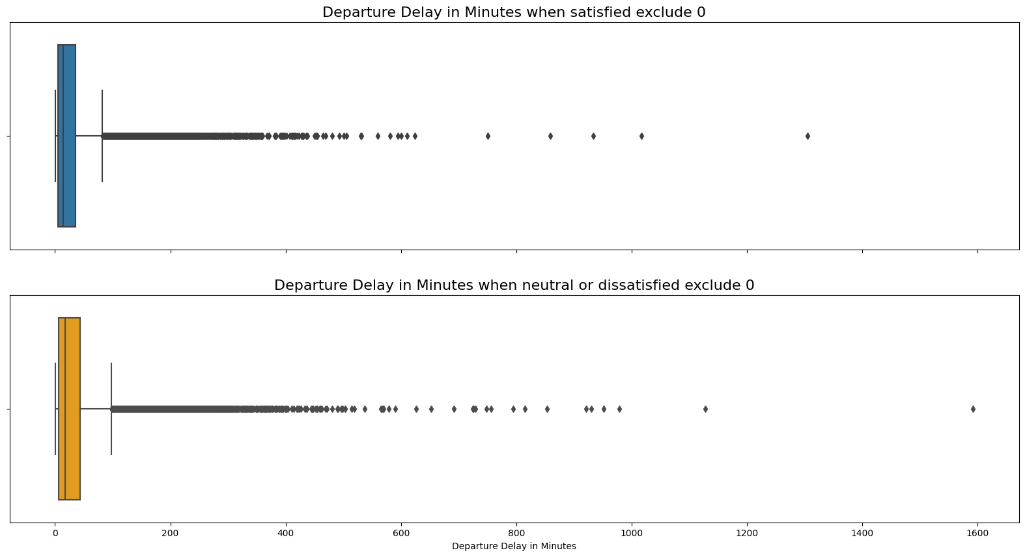
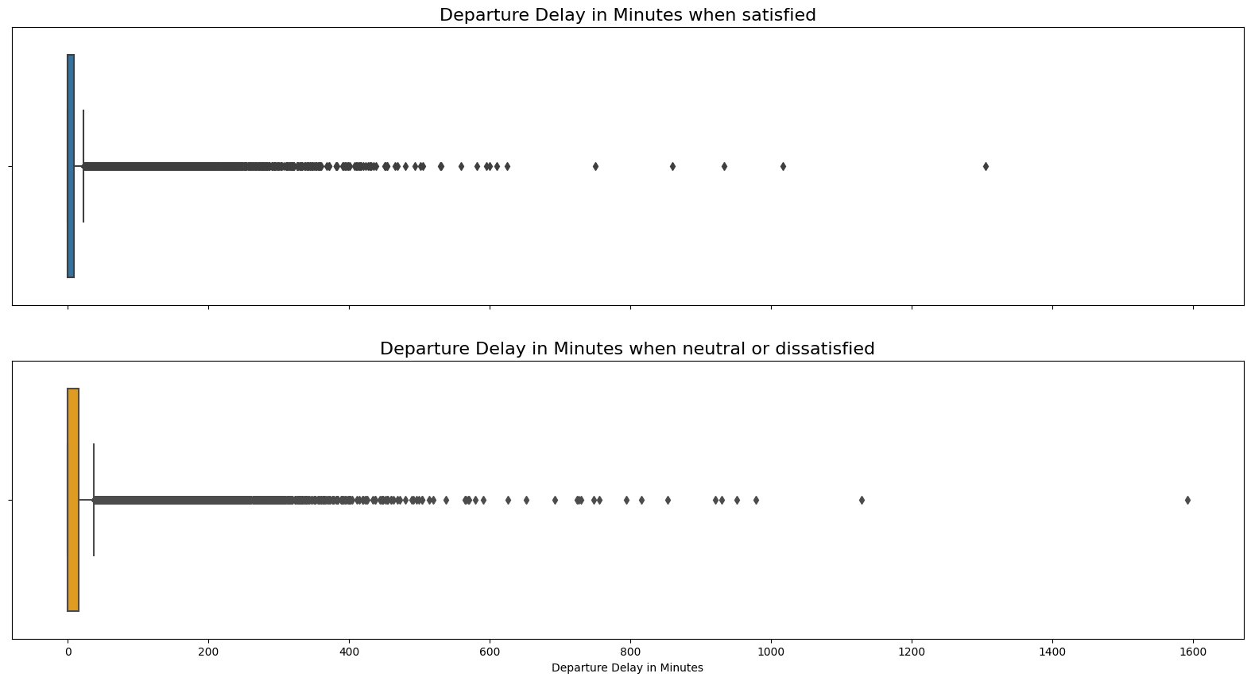
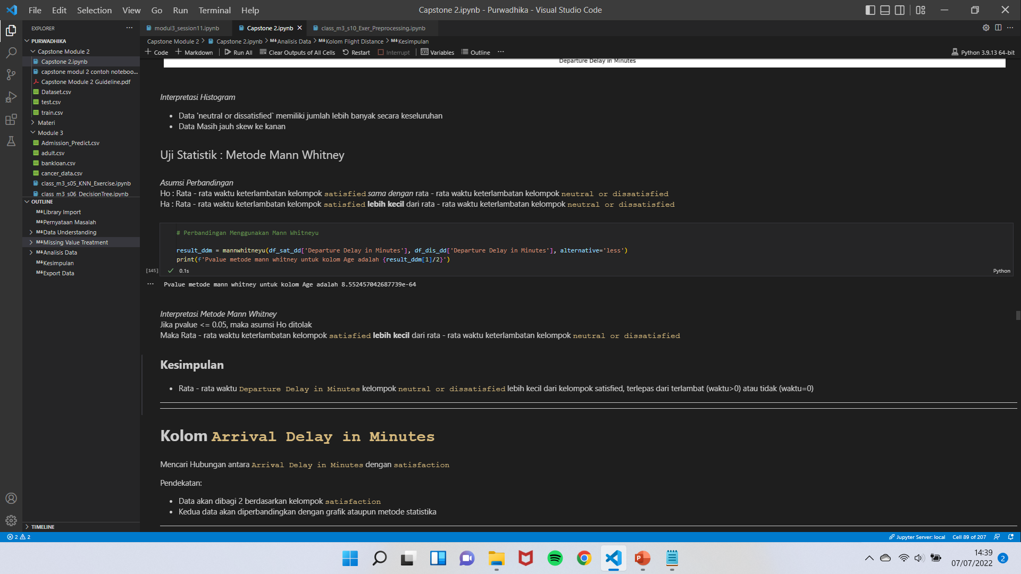
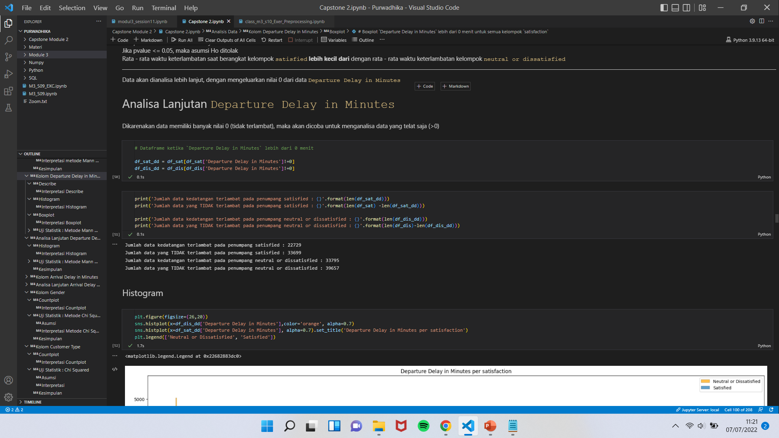
Data Analysis
K
Boxplot tanpa nilai 0
Boxplot dengan nilai 0
Uji Statistik

Slide 12
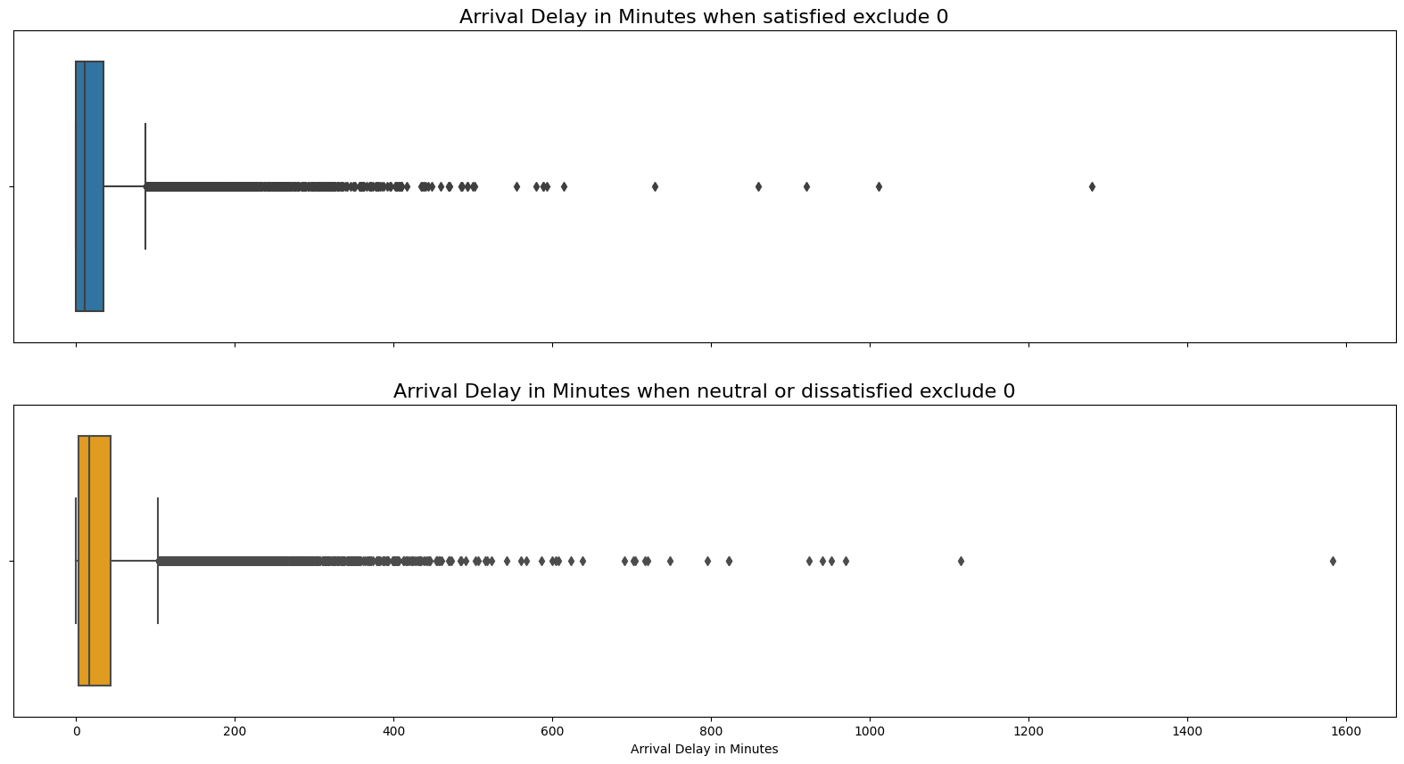
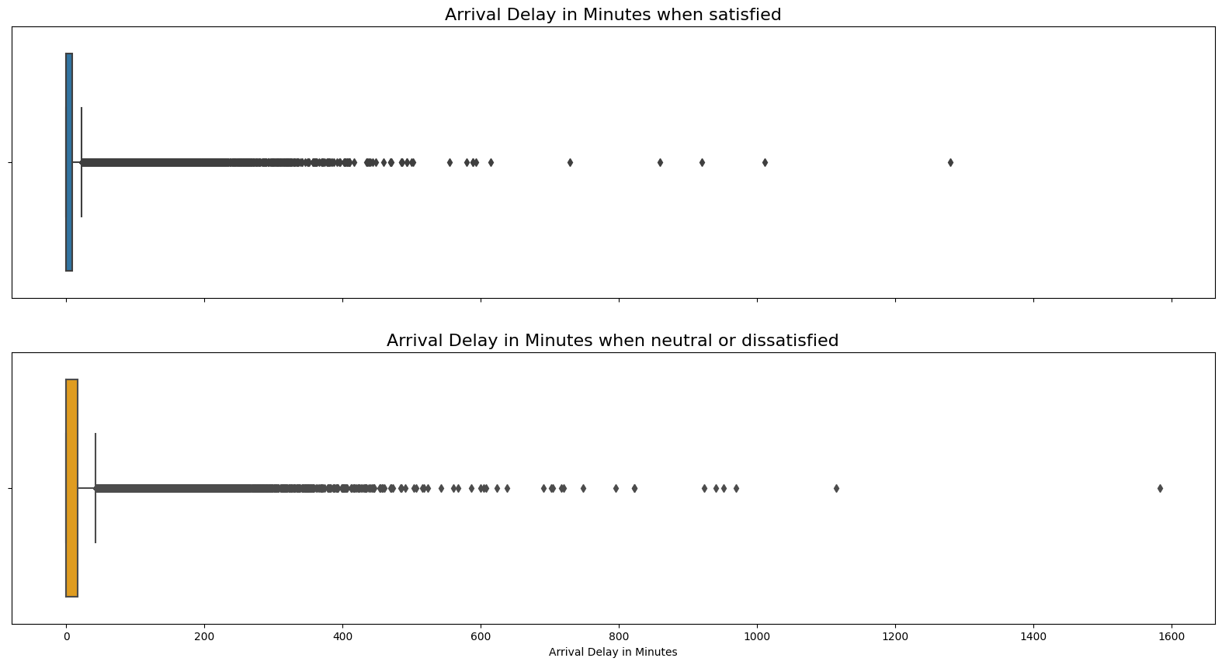
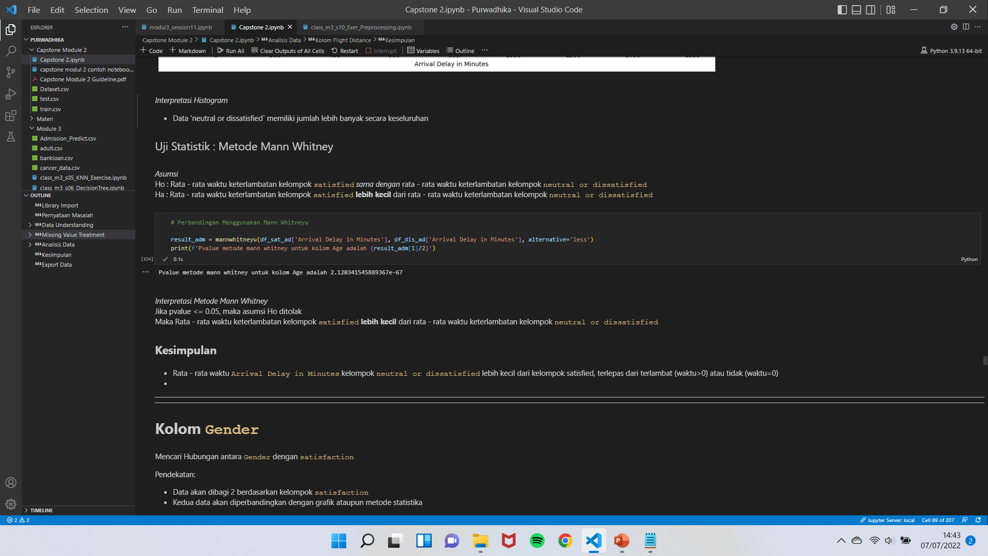
Data Analysis
K
Boxplot tanpa nilai 0
Boxplot dengan nilai 0
Uji Statistik

Slide 13
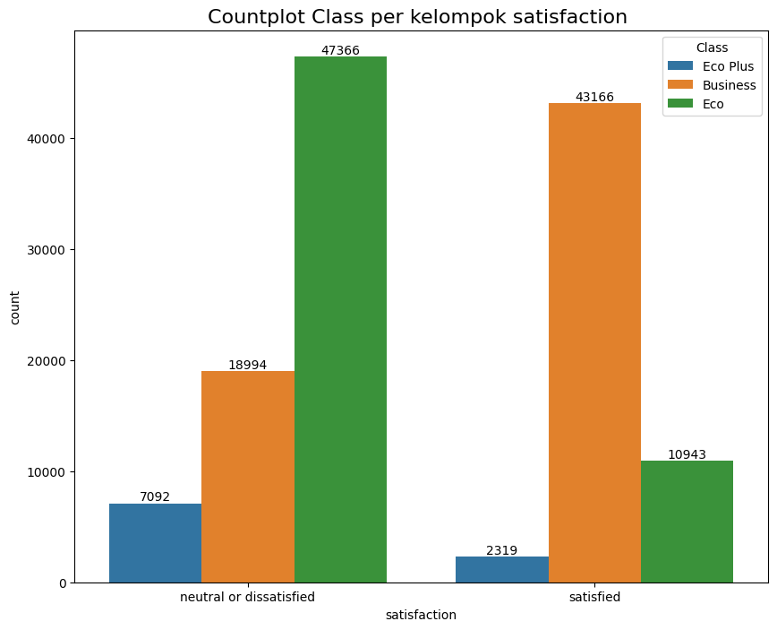
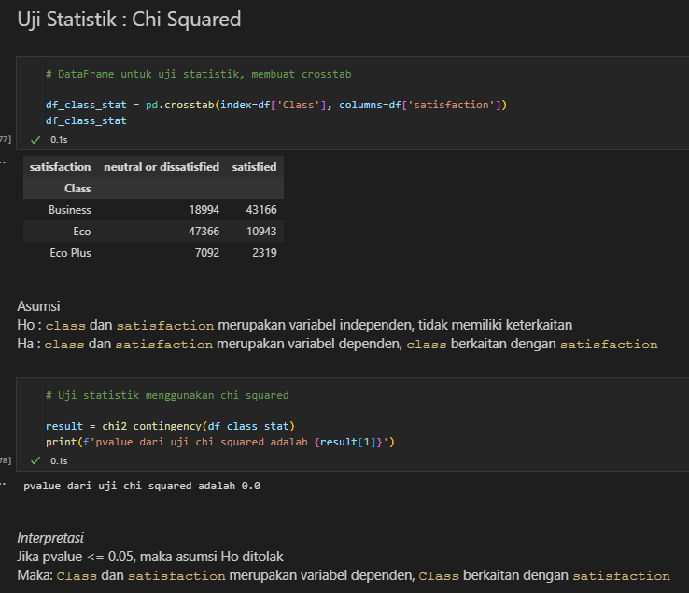
Data Analysis
K
Uji Statistik

Slide 14
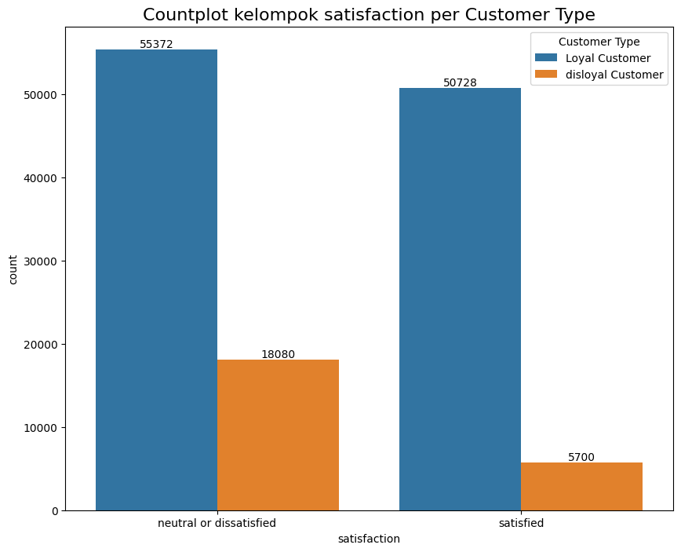
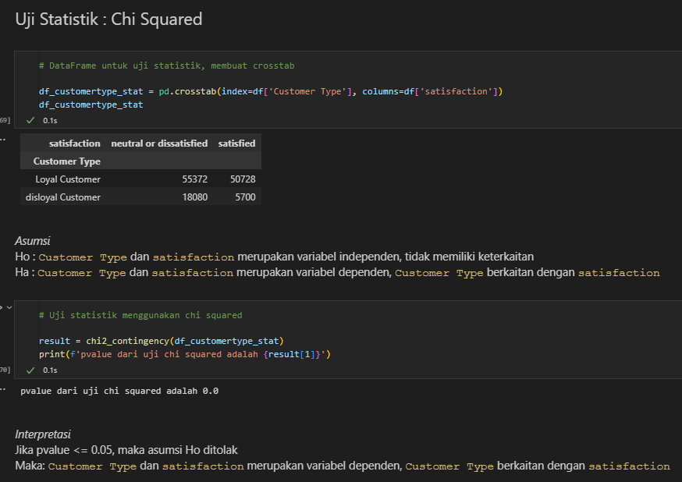
Data Analysis
K
Uji Statistik

Slide 15
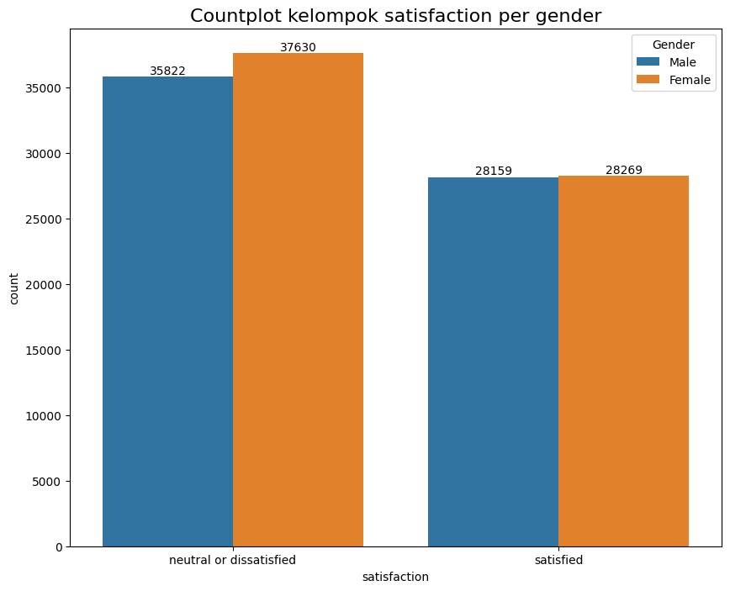
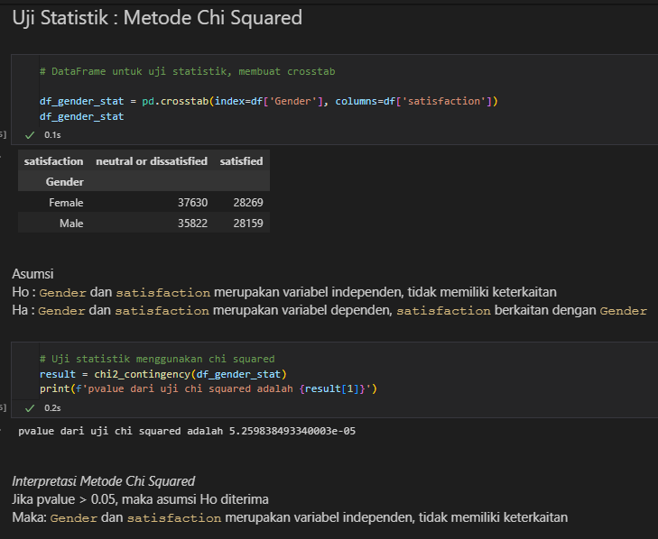
Data Analysis
K
Uji Statistik

Slide 16
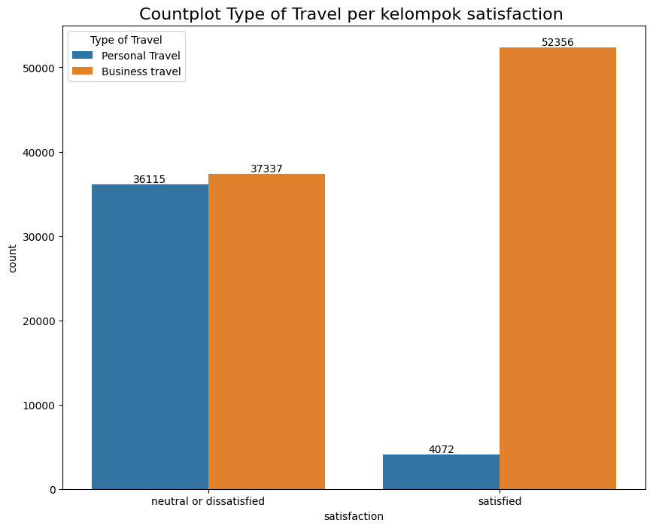
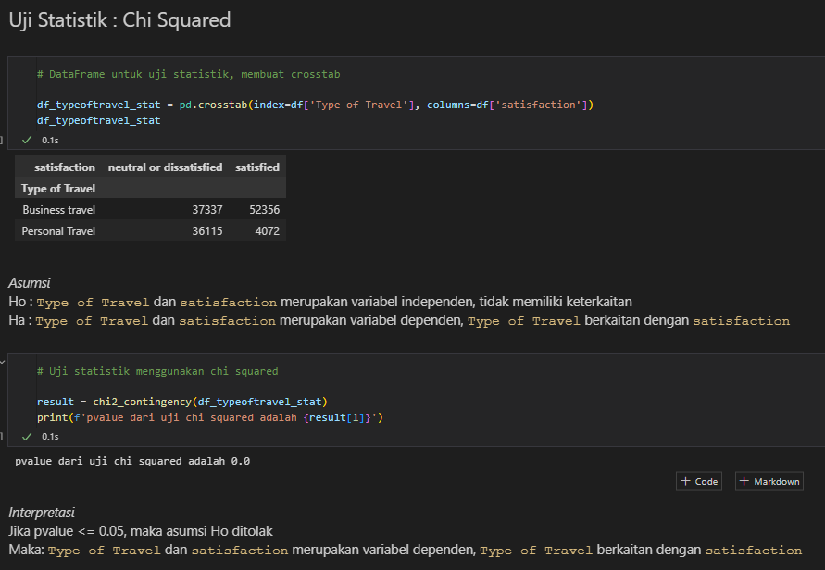
Data Analysis
K
Uji Statistik

Slide 17
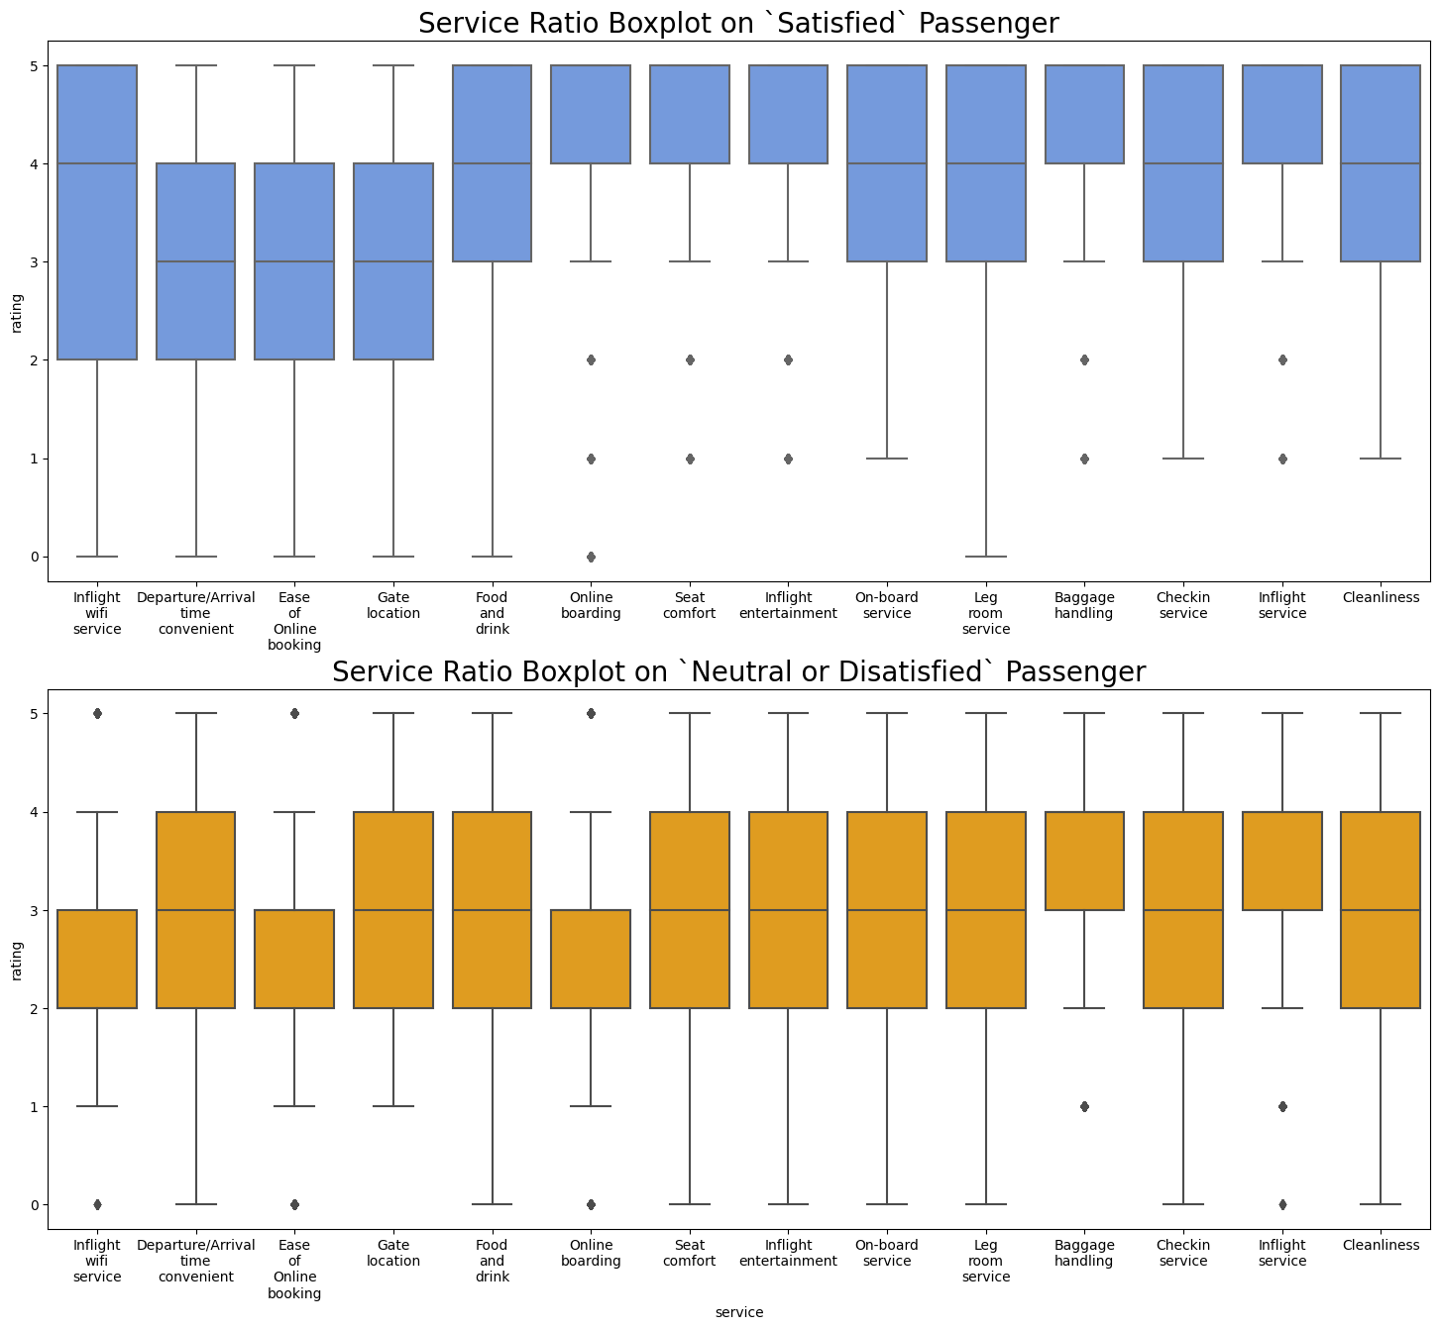
Data Analysis
K

Slide 18
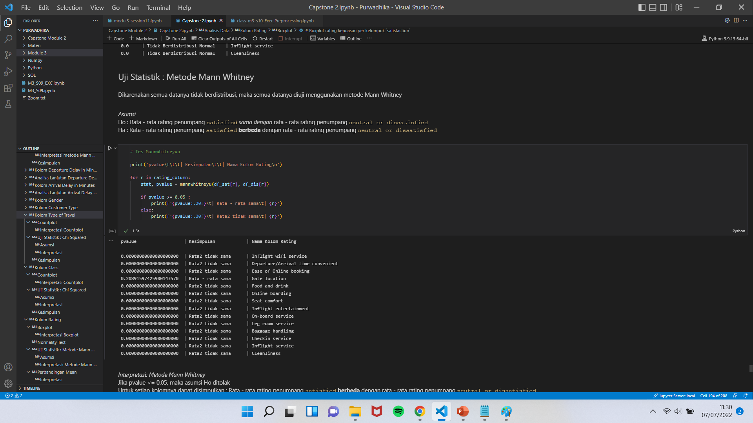
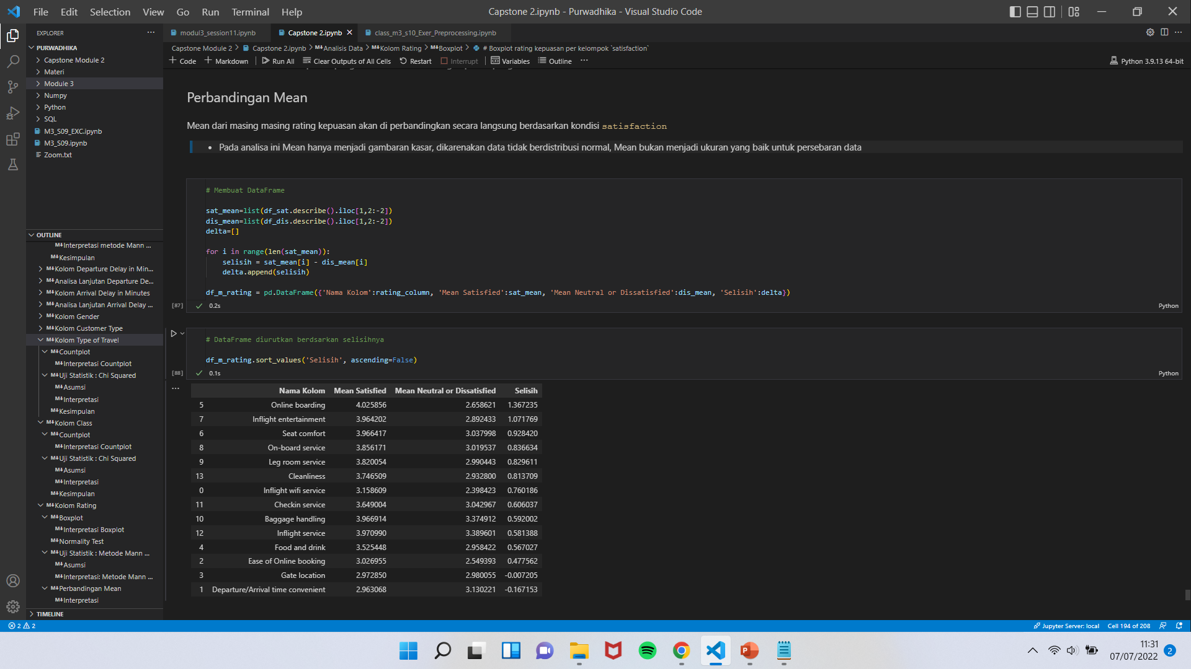
Data Analysis
K
Uji Statistik
Perbandingan Mean

Slide 19
Kesimpulan
K
Online Boarding
Inflight Entertainment
Seat Comfort
Cleanliness
On-Board Service
Leg Room Service
Inflight Wifi Service
Checkin Service
Baggage Handling
Inflight Service
Food and drink
Ease of Online Booking
Departure/Arrival Time Convenient
Persebaran data
Neutral or Dissatisfied Banyak pada:
Arrival Delay in Minutes
&
Departure Delay in Minutes
menjadi faktor tambahan
- Usia lebih muda, sekitar 20 – 40
- Jarak Tempuh di bawah 1750
- Class Eco
- Disloyal Customer
- Personal Travel
Gender tidak berpengaruh terhadap kepuasan penumpang

